Slide 1
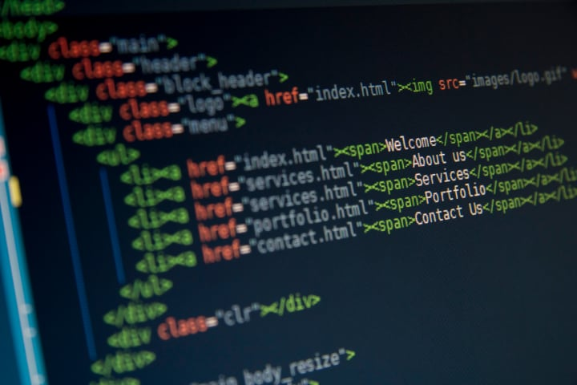

programming language
Matteo Licciardino
4°info
14/11/2022

Slide 2
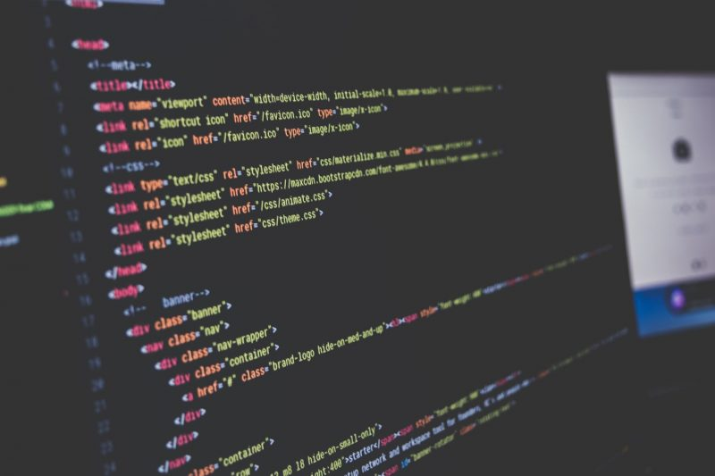

What is a programming language?
A programming language is a language where there are sets of instructions called inputs that produce output data called outputs.
this language develops the abstract concepts of man in machine code, that is the computer language commonly called binary code, that is 0 and 1.

Slide 3
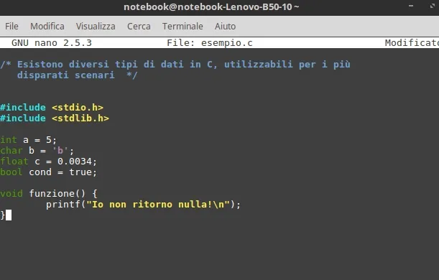
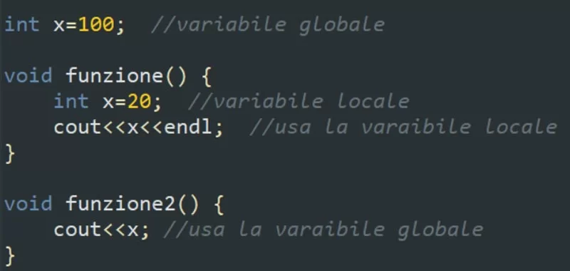
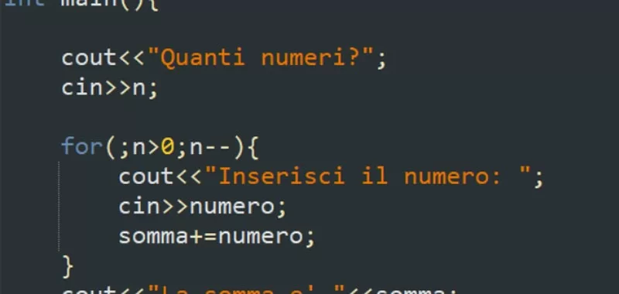
In general, the languages used for software development have some elements in common which are:
- instruction sets are descriptive commands or rules,
- variables and constants is a data to be stored,
- expression is a combination of variables and constants joined by an operator,

Slide 4
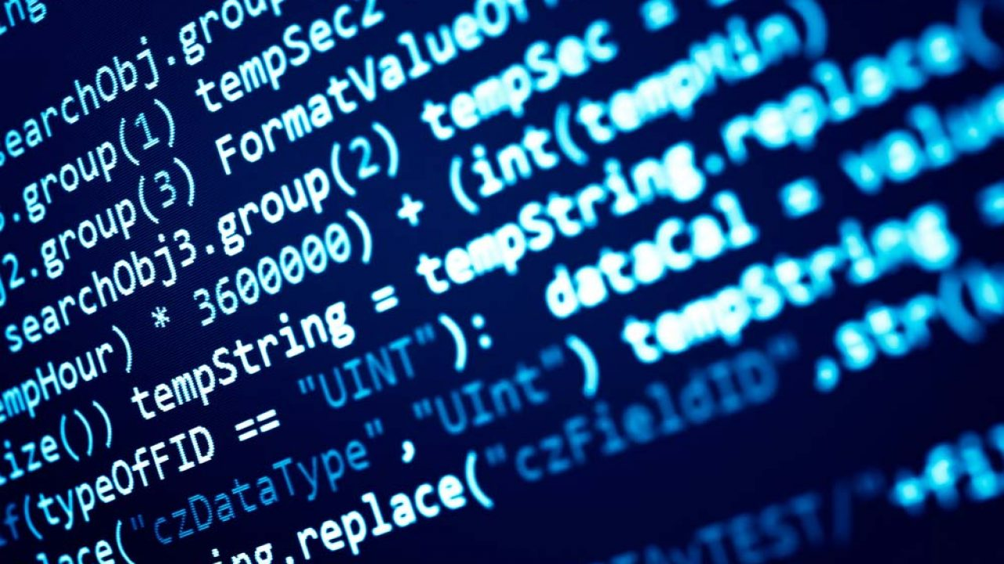
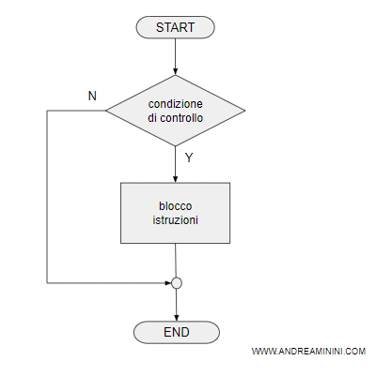

- data structures are a mechanism for managing complex data,
- control structures are a system that directs the flow of program execution,
- the subroutine is a set of source codes that can be called up by the developer.

Slide 5
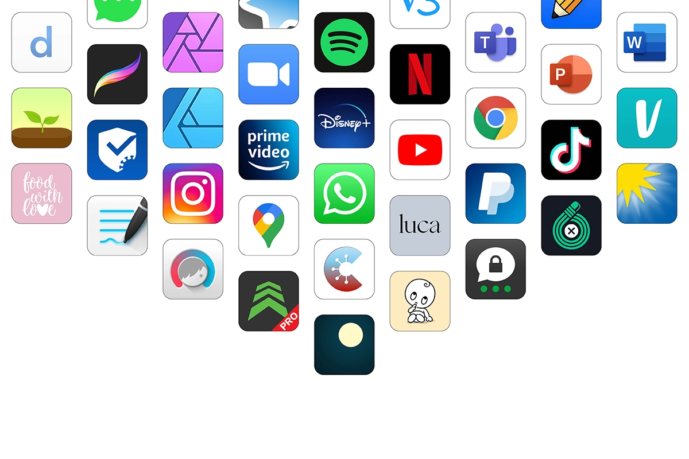
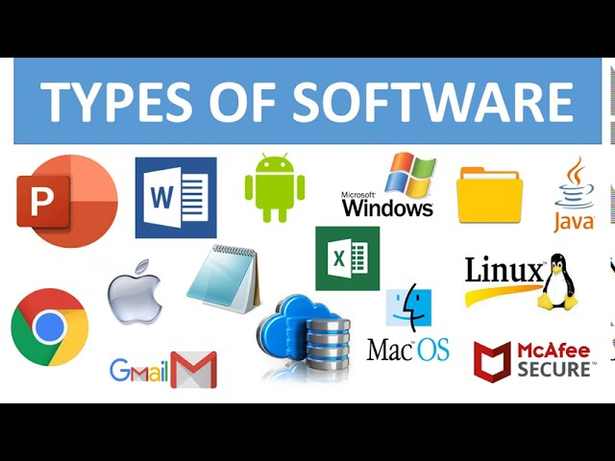
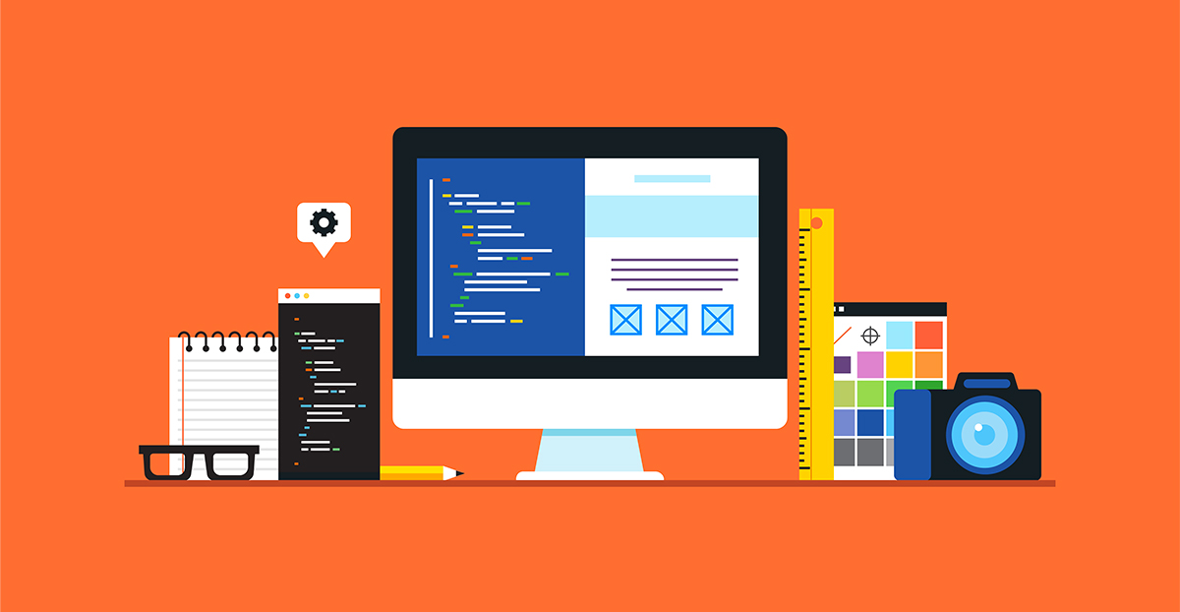

What is a programming language used for?
The programming language allows you to convert ideas, concepts and projects into machine code.
For example:
- create an app,
- create software,
- create a website,
- create a digital interaction.

Slide 6


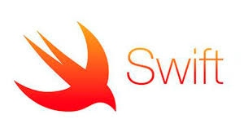
Which programming languages are used lately?
The programming languages that have been used lately are:
- Ruby is an open source programming language, focused on simplicity and productivity and also on object oriented programming.
- Typescript is an open source programming language developed by Microsoft, and is basically an extended version of JavaScript.
- Swift is an object-oriented programming language that was also developed by Apple and is targeted at Apple systems programmers.

Slide 7

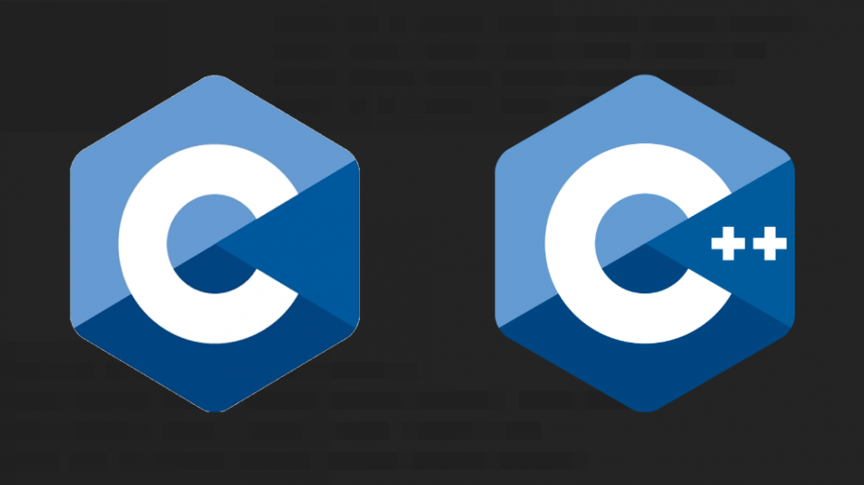
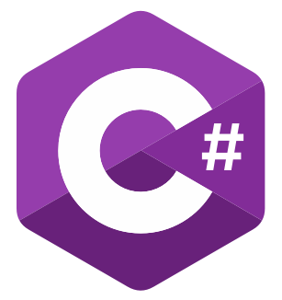
- Go is a programming language developed by Google, supported by both Google and the independent developer community as it is an open-source project. It is a simple language to write like Python and at the same time very efficient like C ++.
- C or C++ are programming languages and are between the most used languages in computer science and are still the basic languages of many operating systems, browsers and video games.
- C# is an object oriented programming language. Developed by Microsoft, it presents itself as a competing language of Java.

Slide 8


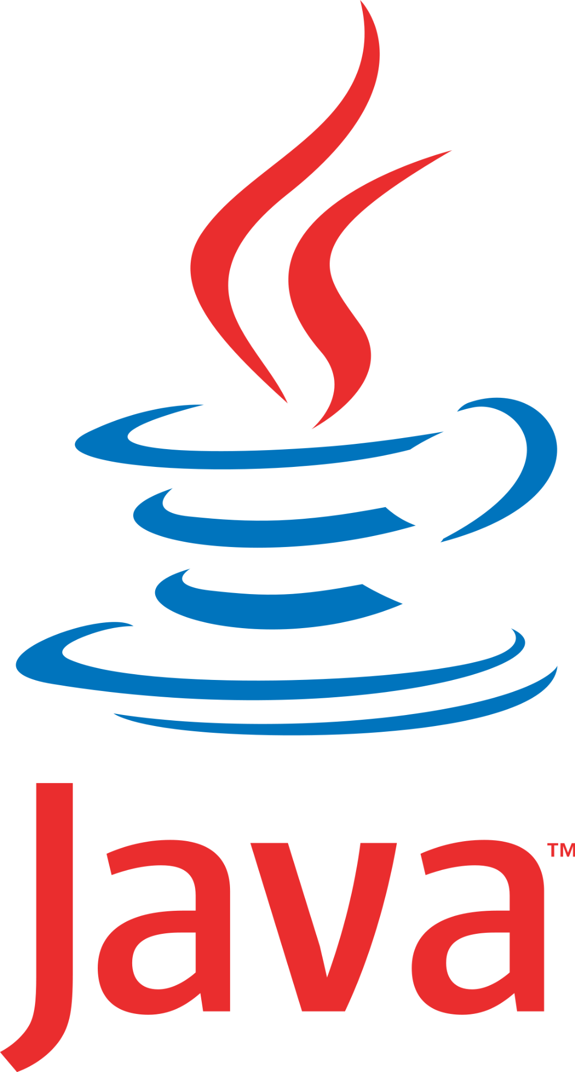

- Php is an interpreted scripting language, with a simple and widely used syntax. PHP supports both an imperative and an object-oriented approach.
- Python is a simple programming language to learn, has an easily readable code and is very flexible and also suitable for object oriented programming.
- Java is the programming language behind the Android operating system, which is the basis for the development of mobile apps and games.
- Javascript is an event-oriented multi-paradigm programming language and also an essential element for the development of websites with dynamic, interactive or animated functions. Therefore, JavaScript is present in much of the web.

Slide 9
thanks for your attention!

